Slide 1


Progress Report: 8
Team Charlie
Aakansha Bhatt, Anshu Paudyal, Ingmar Diaz, Michael Foster, Raunaq Chopra, Yang Ye
25th Feb 2021

Slide 2
Teamwork via zoom
Have to do:
Update the milestone for the Beta prototype

Slide 3
Aakansha Bhatt
Last week 7 | This week 8
Hardware: N/A | Hardware: N/A
Mechanical: N/A | Mechanical: N/A
Firmware: Last week I had 4 midterms and couldn’t work on the project. Next week, I will be working on figuring out the sensors needed for measuring soil moisture and humidity, etc. | Firmware: I researched about the sensors required for the project and we finalized what would be needed. They need to be ordered. Furthermore, I talked with team NASA and they ordered extra shaft encoders and would be willing to give us one so I have been researching about how to write the code for it.
Software: same as above | Software: N/A

Slide 4
Anshu Paudyal
Last Week: 7 | This Week: 8
Hardware: Waiting on the h-bridge still. The delivery got delayed from Digi-key. Testing: of the motor with different connection. Single motor testing, dual motor testing, conclusion just not enough supply of electrons due only 10uF capacitor in the pcb. Research using ADALM to check the PCB as I am having some issues with the connection | I will get h-bridge by tomorrow night and will start the Rigorous testing of the rover system with with h-bridge. I plan to get the rover system ready by next meeting.
Firmware: Research and testing of solar fuel gauge using the OLED display. | Have to start writing code for the solar fuel gauge.

Slide 5
Ingmar Diaz
Last week 7 | This week 8
Hardware: | Hardware:
Mechanical: | Mechanical: Planning to meet with Nick in OH for 3D enclosures suggestions
Firmware: Planning to start developing OLED display code for our display features this weekend Will need capacitors and resistors for analog circuit | Firmware: Implemented a simplified power analysis circuit and tested ADC component of PSOC in Design. Also going to Nick’s OH to see what I can do.
Software: | Software:

Slide 6
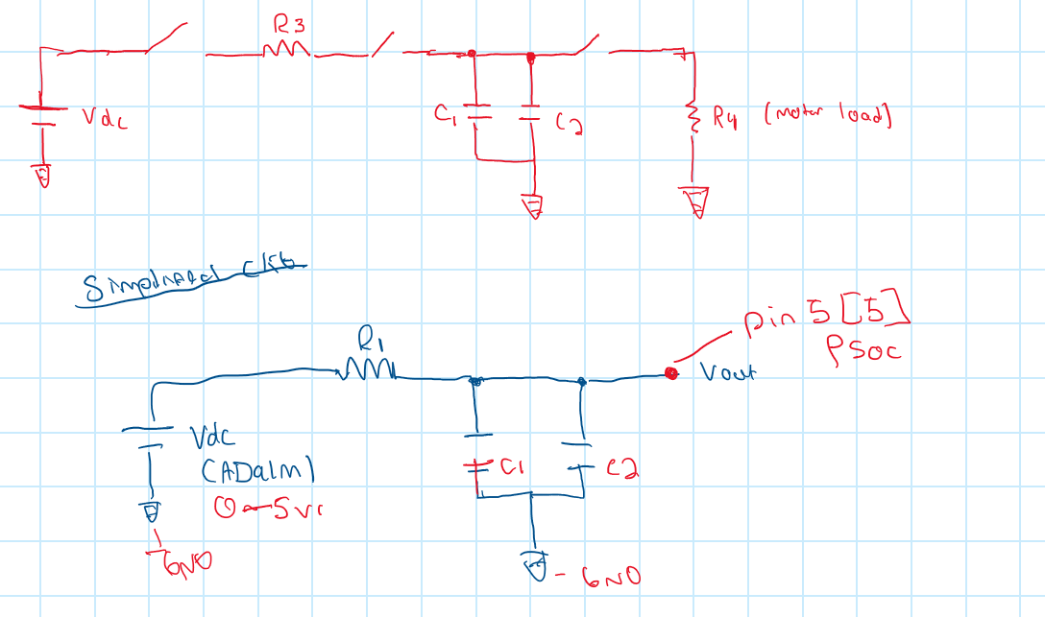
Ingmar Diaz

Slide 7
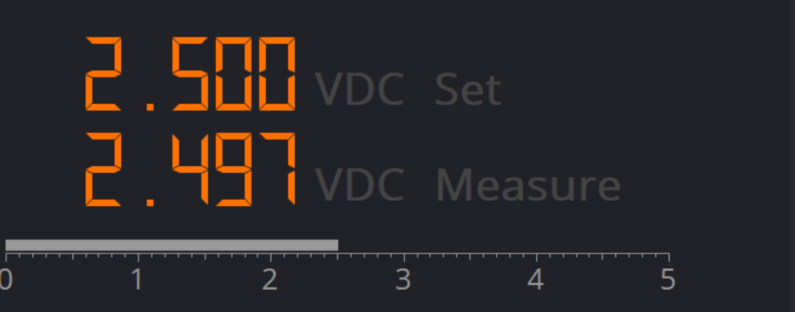
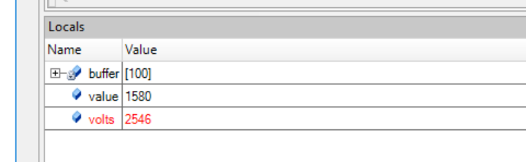
Ingmar Diaz
The Good: We are able to read values using the ADC and the power supply of ADALM.

Slide 8
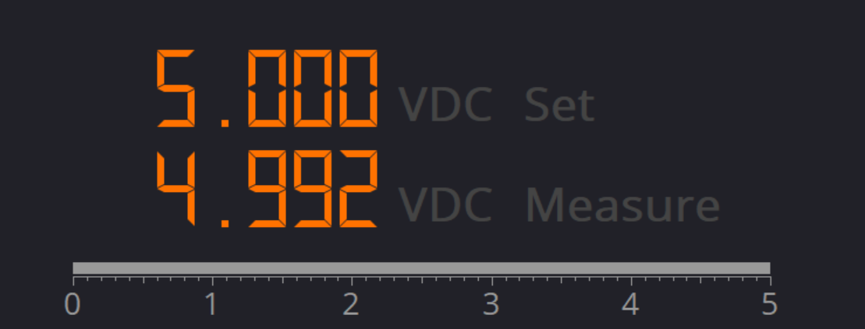
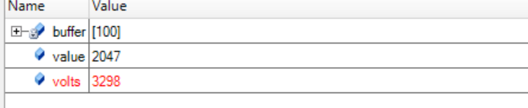
Ingmar Diaz
The Bad: The PSOC 6 max Vref value is capped at 3.3 V.

Slide 9
Michael Foster
Last Week: 7 | This Week: 8
Hardware: N/a | Hardware: N/a
Mechanical:N/a | Mechanical:N/a
I felt like I was getting somewhere in the software solar fuel gauge, but I had to step away due to being ill. I get my results back tomorrow or saturday for covid. | After resting this weekend and this week, I feel like I am fully recovered and began continuing my part on my part. Still trying to figure out how to implement the battery via
Extremely hard to concentrate with this and haven’t been able to get any class work done. | Psoc, or to implement into the OLED.

Slide 10
Raunaq Chopra
Week 8:
Hardware: After the alpha prototype, we decided we will transition to an IC for the H-bridge, along with some other features for which the details were discussed today. The plan is to include all of these include all of these into the existing PCB design as well as reconfiguring it to fit properly on the rover chassis. This week I mostly tried looking for datasheets to know more for the PCB design
Week 9:
Hardware: I will be using the information from over the week to redesign the PCB. I am yet to ask Anshu for the amount of space available for the PCB on the chassis but will be taking that into consideration when doing the redesign.
Firmware: I will be coordinating with the team based on the requirements to for the GPS feature.

Slide 11
Yang Ye
Hardware: The video captured by the camera on the rover can be transmitted remotely to a receiver. The data stream will be then processed by the PC terminal. using OpenCV libraries)
Firmware: Setting up AV video signal converter
Software: Compiling OpenCV library.

Slide 12
Bill of Materials and Project Budget:
Rover Truck + Solar Panels +
SPDT switches + 10x*0.1F capacitors +
Box of capacitors +
shipping for Switches and cap = $87.42 + $13.00 + $8.28 + $18.39 + $13.39 ~ $140.48
Project Schedule and Risk Assessment: MILESTONES - Google Docs
Report and Presentation: 12th Feb 2021
Marketing and Video: 11th Feb 2021
Tips:
1. Be sure to identify tasks and contributions of each team member.
2. Use pictures as much as possible for effective communication.

